Slide 1
Unlocking Opportunities: Enhancing Military Credit Recognition at EKU
Transfer & Articulation Community of Practice
August 2024

Slide 2
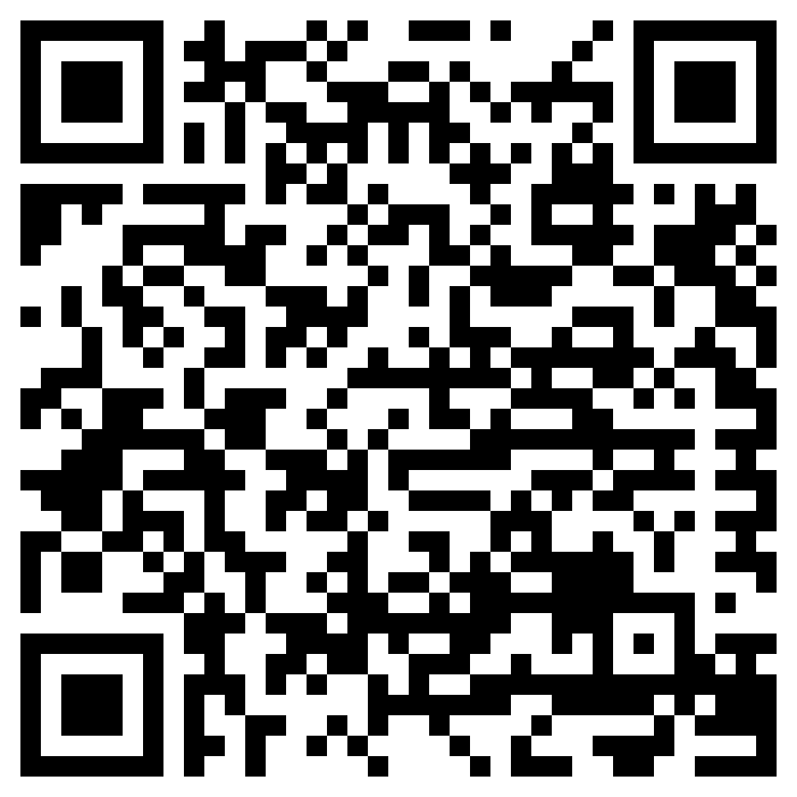
Quick Housekeeping
Does your name appear correctly when you sign into our Community of Practice (CoP) webinars?
If no, register to attend future CoP’s using the QR code or go to our website
Delete the former calendar event
Add the new one you’ll receive after registering
We also post recordings and slide decks to this website!

Slide 3
What CPL Isn’t
What CPL Is

Slide 4
Credit for Prior Learning: Military Credit
“The PLA Boost”
“Take-up” rate of CPL for service members much higher than civilians
Credential completion higher among service members with CPL
92% of service members’ credit from ACE recommendations
43%
35%
Source: Klein-Collins, R., Taylor, J., Bishop, C., Bransberger, P., Lane, P., Leibrandt, S., Council for Adult and Experiential Learning (CAEL), & Western Interstate Commission for Higher Education (WICHE). (2020). The PLA boost: Results from a 72-institution targeted study of Prior Learning Assessment and adult student outcomes. In Council for Adult and Experiential Learning. Council for Adult and Experiential Learning. https://eric.ed.gov/?id=ED608563
Notes:
CPL becoming increasingly important
-Method to help the “some credit no degree” population (higher percentage of adults with CPL complete credentials, minoritized populations receive strong boosts but also least likely to receive credit)
-The “take-up” rate is much higher among service members (43%) compared to non-service members (3%) = Opportunity to impact large population of students!
-Higher percentage of service members completed credentials (35%) than service members without CPL (21%)
-92% of credit awarded to service members in the study were from ACE recommendations

Slide 5
Unlocking Opportunities: Enhancing Military Credit Recognition at EKU
Presenter: Audrie Smith
Associate Director of Office of Articulation and Transfer Systems
Eastern Kentucky University
Notes:
CPL becoming increasingly important
-Method to help the “some credit no degree” population (higher percentage of adults with CPL complete credentials, minoritized populations receive strong boosts but also least likely to receive credit)
-The “take-up” rate is much higher among service members (43%) compared to non-service members (3%)
-Higher percentage of service members completed credentials (35%) than service members without CPL (21%)
-92% of credit awarded to service members in the study were from ACE recommendations

Slide 6
Unlocking Opportunities:
Enhancing Military Credit Recognition at Eastern Kentucky University
Audrie Smith
Associate Director
Office of Articulation and Transfer Systems

Slide 7
Recognition of Credit Earned
Student Outreach and Transition Office
Beginning the process of reviewing JST’s for academic credit.
SOTO was established to support transfer, adult, and returning students. Military student support under this umbrella
Basic Training Credits
6 credit hours in Military Science courses & 3 credit hours in Physical Education courses
Operation Veterans Success
A series of initiatives developed to support military students
Military Times Edge Magazine
Nationally Ranked EKU as Number One “Best for Vets” Institution
Office of Military and Veteran Affairs
OMVA established to accommodate the growing number of military students
The Beginnings

Slide 8
No admission fees for undergraduate veterans.
In-state tuition for all out-of-state veterans nationwide.
Maximum credit hours for military experience.
Priority registration.
Book vouchers and Books for Boots Exchange Library.
Veterans Bridge to College Success cohort classes.
Veterans orientation course.
Veteran-helpful withdrawal and readmission policy.
Vet-2-Vet sponsorship program and active Vets Club.
Recreational and other extracurricular activities.
Specially designated housing for student veterans.
Veteran Studies minor, believed to be the nation’s first, to help those who haven’t served in the military to better understand the issues that veterans face, and to help the veterans themselves deal with those issues.
The Beginnings

Slide 9
Recognition of Credit Earned
Student Outreach and Transition Office
Beginning the process of reviewing JST’s for academic credit.
SOTO was established to support transfer, adult, and returning students. Military student support under this umbrella
Basic Training Credits
6 credit hours in Military Science courses & 3 credit hours in Physical Education courses
Operation Veterans Success
A series of initiatives developed to support military students
Military Times Edge Magazine
Nationally Ranked EKU as Number One “Best for Vets” Institution
Office of Military and Veteran Affairs
OMVA established to accommodate the growing number of military students
The Beginnings

Slide 10
Who is Involved?
Student Submits JST
Registrar’s Office Processes
OATS Initiates Course Articulation
OMVA Review
OATS sends these courses to academic departments for review and evaluation of EKU credit.
Student requests an official copy of their JST to be sent to EKU.
The OMVA reviews JST for benefit purposes and communicates courses to the Registrar for recording.
Registrar records courses to student record.
1
2
3
4
Basic Training
Six credit hours in Military Science Leadership courses
Three credit hours in a Physical Education course.

Slide 11
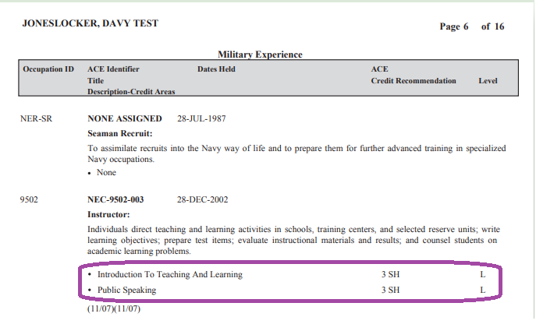
The “Old Way”
NAVY 1001-Introduction to Teaching And Learning-3 credit hours
NAVY 1002-Public Speaking-3 credit hours
All equivalencies for military courses are housed under an “ACE” institution code.
Students receive CR credit- they get the credit hours, but it doesn’t affect the GPA.

Slide 12
Continuation
Courses are created on a case-by-case basis.

Slide 13
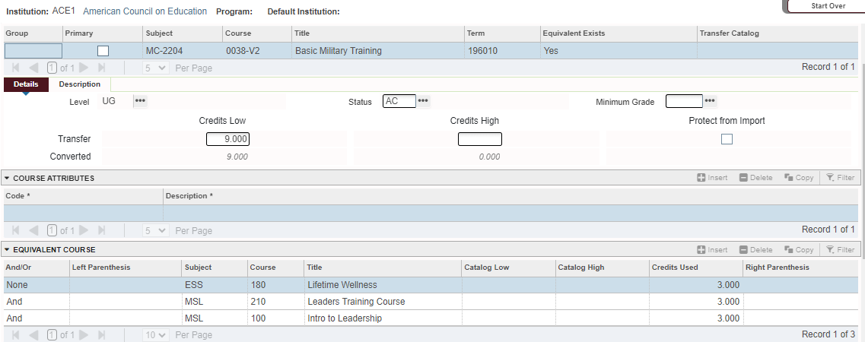
The “New Way”

Slide 14
-
Easy to locate on OMVA’s webpage.
Allows students to search potential credits based on Military occupation.

Slide 15
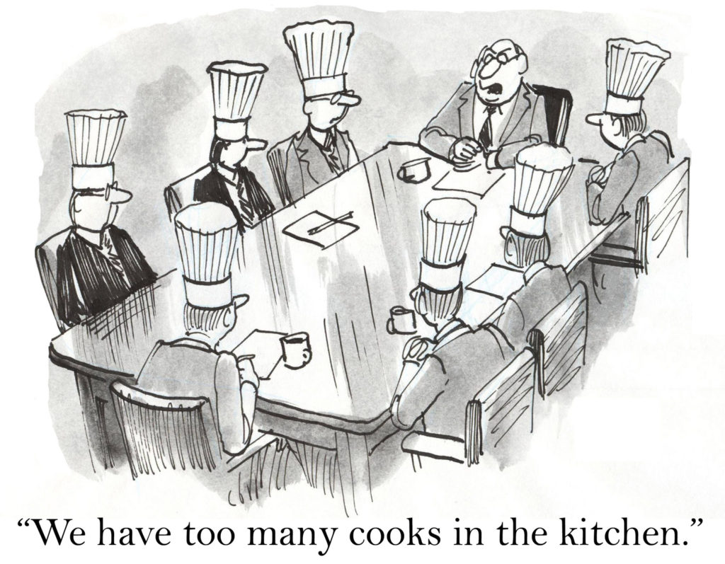
Roadblocks
Multiple offices involved
Personnel changes
Undocumented processes
Where does ownership belong

Slide 16
Future Innovations Proposal
VetsReady Opportunity Portal
New ACE Military Guide Portal
Reducing redundant processes
Record directly from JST
Reducing the number of offices involved
Determine ownership following reduction of involved offices in process
Developing and maintaining a proactive approach to credit evaluation
Document all processes and house in a central location

Slide 17
Questions?
Audrie Smith
Associate Director
Office of Articulation and Transfer Systems
(859) 622-1098 / Audrie.Smith@eku.edu

Slide 18
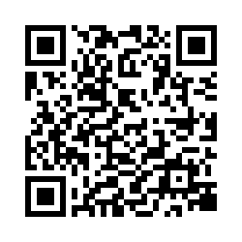
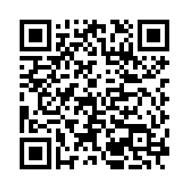
Feedback
Present
Please share your feedback with us!
Interested in being a presenter for a future Community of Practice webinar?
AACRAO Transfer & Articulation Committee: Community of Practice Webinars Feedback
AACRAO TAC: Submit a Proposal to Present at an Upcoming Community of Practice Webinar

