Slide 1
Supporting Transcript Evaluators: What They Need to Know to Be Successful AACRAO Webinar June 2024

Slide 2
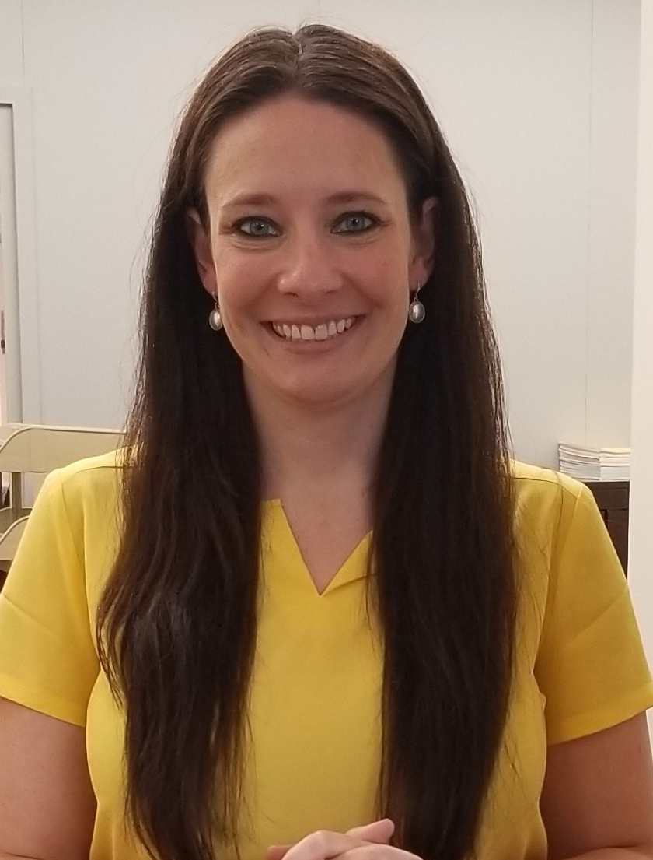
Hello!
Katie A. Schwienteck
Registrar
Penn State University – York Campus

Slide 3
Transcript Evaluation
IMPORTANCE OF THE TRANSCRIPT EVALUATOR
ESSENTIAL KNOWLEDGE BASE
HOW TO READ A TRANSCRIPT
HOW TO READ A COURSE DESCRIPTION
TECHNOLOGY TOOLS
PROFESSIONAL DEVELOPMENT & NETWORKING

Slide 4
10 Things Every Transcript Evaluator Should Know
KNOW TYPES OF CREDIT
KNOW COMPONENTS OF A TRANSCRIPT AND HOW TO INTERPRET THEM
KNOW HOW TO READ COURSE DESCRIPTIONS
KNOW YOUR INSTITUTION & POLICIES GUIDING ARTICULATION
KNOW HOW TO USE TECHNOLOGY
KNOW FERPA
KNOW HOW TO EXPLAIN WHAT YOU DO AND WHY THE ROLE IS ESSENTIAL
KNOW HOW TO BUILD RELATIONSHIPS
KNOW HOW TO BE CREATIVE
KNOW THE EXTERNAL RESOURCES

Slide 5
KNOW TYPES OF CREDIT
Lower level credit (001-099 numbering system)
Graduate vs. undergraduate
Continuing Education credit
Technical credit
Repeated courses
Institutional credit vs. transfer credit
Study abroad credit
Dual enrollment credit
Partnership program credit
Credit for life experience/prior knowledge
Military credit
Credit by exam (institutional, AP, IB, CLEP, DSST, etc)
1

Slide 6
KNOW COMPONENTS OF A TRANSCRIPT AND HOW TO INTERPRET THEM
Each transcript is different, become familiar with those differences
Key items to familiarize yourself with:
Terms
Grading Scale
Credit Hours
Course Numbering
General Education Designations
Institution Hours/Credit
Previous transfer credit
Degree awarded
GPA hours, earned hours, overall GPA
2

Slide 7
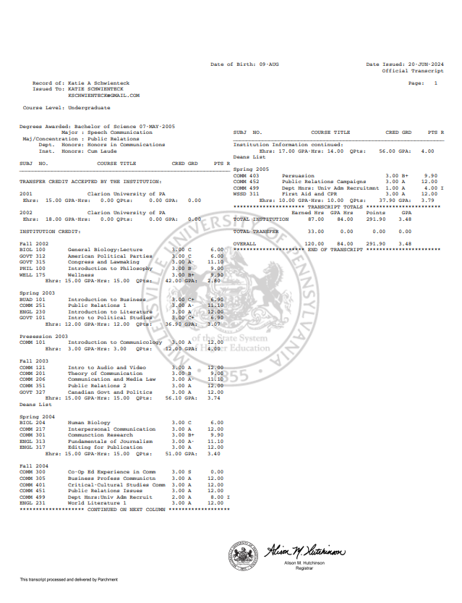
KNOW COMPONENTS OF A TRANSCRIPT AND HOW TO INTERPRET THEM
2

Slide 8
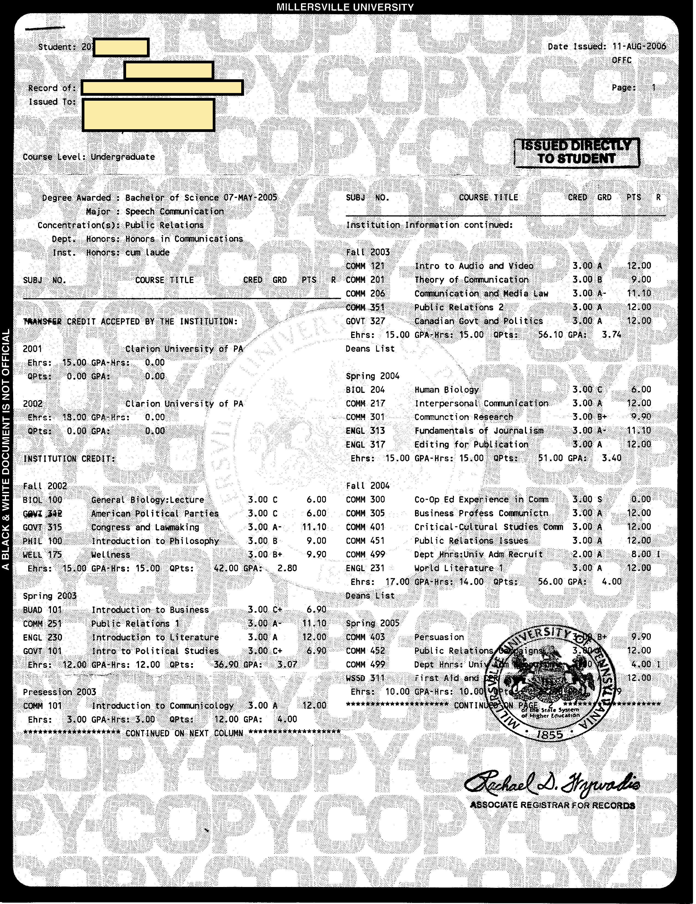
KNOW COMPONENTS OF A TRANSCRIPT AND HOW TO INTERPRET THEM
2

Slide 9
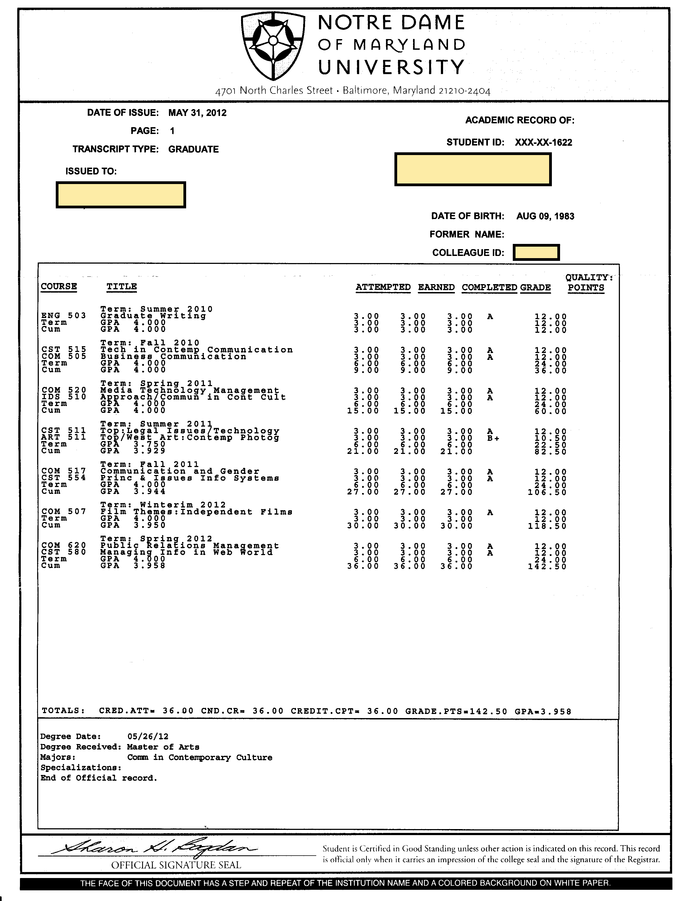
KNOW COMPONENTS OF A TRANSCRIPT AND HOW TO INTERPRET THEM
2

Slide 10
helpful hint:
Read the “back” of the transcript
Reach out to the school

Slide 11
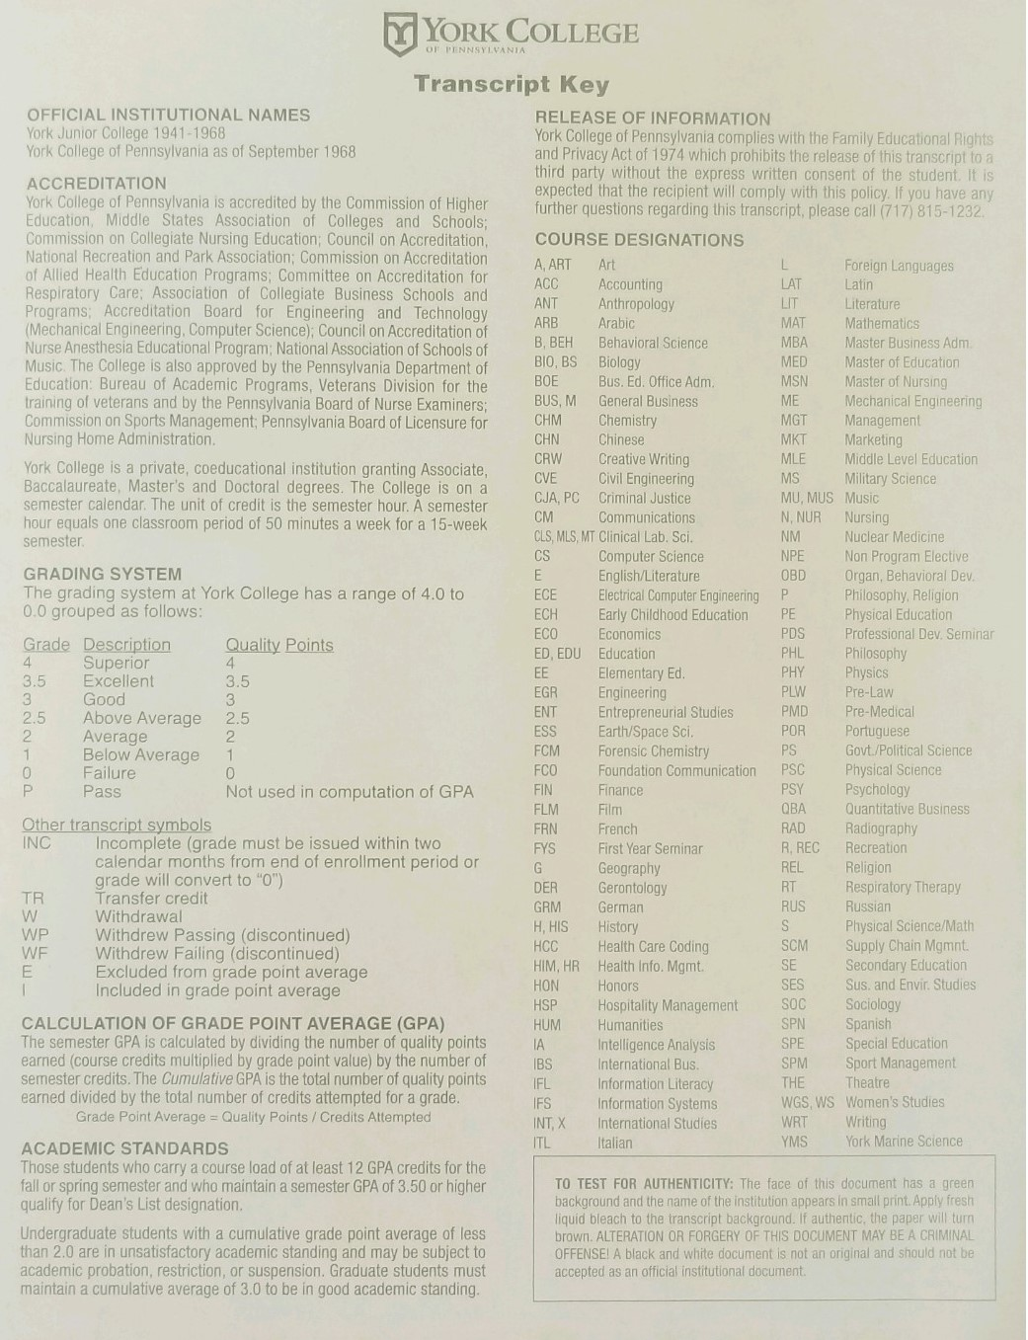
KNOW COMPONENTS OF A TRANSCRIPT AND HOW TO INTERPRET THEM
2

Slide 12
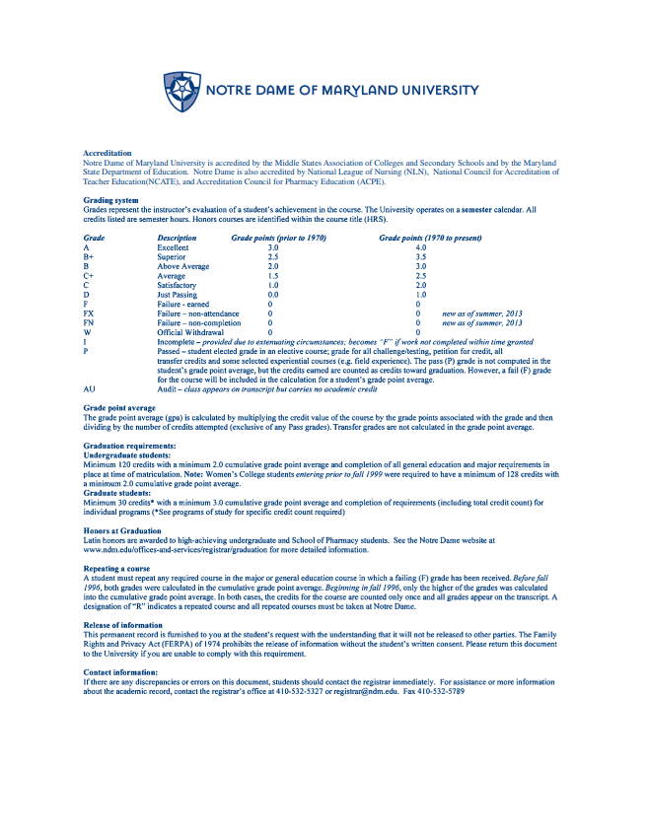
KNOW COMPONENTS OF A TRANSCRIPT AND HOW TO INTERPRET THEM
2

Slide 13
KNOW HOW TO READ COURSE DESCRIPTIONS
Every course description is different:
Length
Content
Details
What does your institution want in a course description?
Know policies that drive what you are looking for:
Key topics
Content match
Level
Pre-requisites
Total hours
3

Slide 14
KNOW HOW TO READ COURSE DESCRIPTIONS
GOVT 111: 3 s.h.
Introduction to American Government (G3)
Introduction to the major tenets of the American political system. Offered fall, spring.
vs
3
GVPT 170 American Government (3)
A comprehensive study of government in the United States, including the basic principles of American government and political culture. The aim is to explain the vertical and horizontal structure of the American government and the roles of the three federal branches, bureaucracies, and the state governments; describe the development of the American political system and its impact on the political landscape; and explain the processes of the electoral system, political parties, and interest groups to persuade and influence. Institutions, processes, and public policies are examined from a cross-cultural perspective.

Slide 15
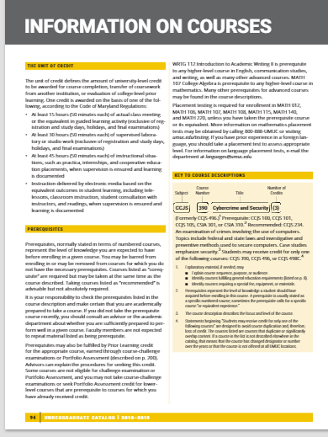
helpful hint:
Use the institution’s catalog as a resource
3

Slide 16
KNOW YOUR INSTITUTION & POLICIES GUIDING ARTICULATION
What to know…
The evaluator role within the institution
The curriculum
Components of the degree
General education structure
Institutional policies regarding transfer credit
4

Slide 17
KNOW YOUR INSTITUTION & POLICIES GUIDING ARTICULATION
Institutional policies regarding transfer credit
Accreditation
What equals a match?
Who decides equivalency?
What does the decision process look like?
When is the official evaluation completed?
What is the process for informing the student?
Transfer credit limit
Transfer credit limit into the major
Transfer credit limit into general education
Residency credit requirements
Are these policies and procedures benefiting the student?
4

Slide 18
helpful hint:
It might be time to update…
Policies set and guide your institution’s rules and regulations
Procedures are the mechanisms to support (and enforce) policy

Slide 19
KNOW HOW TO USE TECHNOLOGY
Technology is your transfer articulation friend!
Get solid training on the articulation database
Make your articulation database student facing
Know the capabilities of your SIS
Explore software that will help with maintaining a database
Explore software that will help with procedure
Catalog searches
5

Slide 20
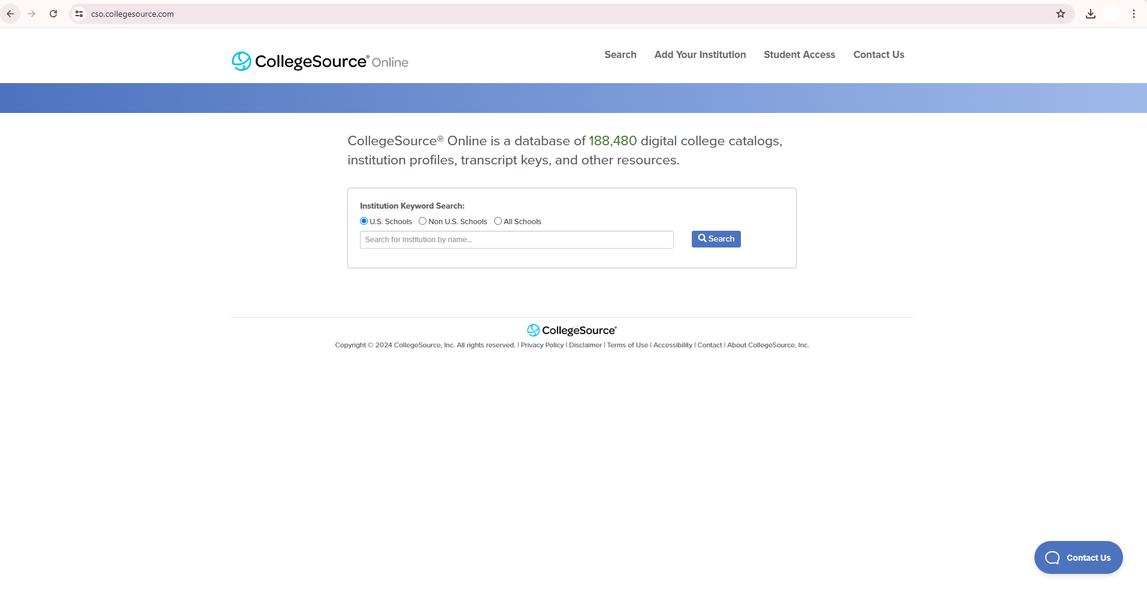
KNOW HOW TO USE TECHNOLOGY
Place your screenshot here
5

Slide 21
KNOW FERPA
FERPA – Family Educational Rights and Privacy Act
Know how FERPA relates to transfer credit questions and access to information by students, families, faculty & staff
Know your institution’s published transfer policy
6

Slide 22
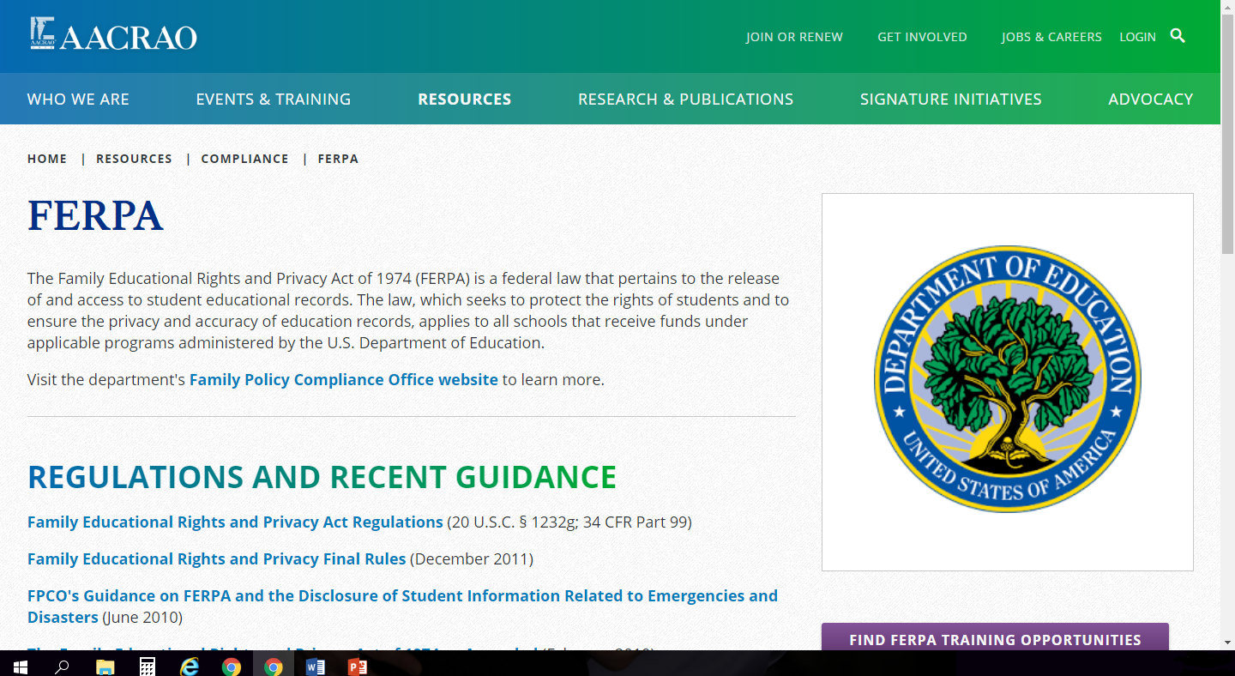
helpful hint:
https://www.ed.gov/ferpa
https://www.aacrao.org/resources/compliance/ferpa
6

Slide 23
KNOW HOW TO EXPLAIN WHAT YOU DO AND WHY THE ROLE IS ESSENTIAL
Utilize your job description
Use terms that faculty, staff, peers and students will understand
Understand how transfer student success is important at your institution
Make links between your job functions and your office’s mission
Make links between your job functions and the institution’s mission
7

Slide 24
KNOW HOW TO BUILD RELATIONSHIPS
Who are your key stakeholders?
Students
Supervisor
Senior level administration
President
Faculty
Deans & Department Chairs
Families
Colleagues
Partner institution administration, faculty, staff & students
Use those INTERPERSONAL COMMUNICATION skills
Establish good relationships
Earn trust and professional autonomy
Make professional connections
Use it as an opportunities to educate others
NETWORK!
8

Slide 25
KNOW HOW TO BE CREATIVE
Use critical thinking skills
Use critical listening skills
Ask good questions
Think about where you have the ability to make adjustments
Think about where you can effect change in policy & procedure
Make sure your creativity correlates with student success
9

Slide 26
helpful hint:
Work with the general education coordinator(s) on your campus. They can be good advocates for transfer credit and time to completion
Think about how you can be creative with your transfer policy as it aligns with mandated policy
If you see a way to improve, suggest it!

Slide 27
KNOW THE EXTERNAL RESOURCES
Professional Development
Accreditation documents
State guidelines
Listservs
Publications
Professional networks
10

Slide 28
RECAP: 10 Things Every Transcript Evaluator Should Know
KNOW TYPES OF CREDIT
KNOW COMPONENTS OF A TRANSCRIPT AND HOW TO INTERPRET THEM
KNOW HOW TO READ COURSE DESCRIPTIONS
KNOW YOUR INSTITUTION & POLICIES GUIDING ARTICULATION
KNOW HOW TO USE TECHNOLOGY
KNOW FERPA
KNOW HOW TO EXPLAIN WHAT YOU DO AND WHY THE ROLE IS ESSENTIAL
KNOW HOW TO BUILD RELATIONSHIPS
KNOW HOW TO BE CREATIVE
KNOW THE EXTERNAL RESOURCES

Slide 29
QUESTIONS
COMMENTS
DISCUSSION

Slide 30
THANK YOU!
CONTACT ME
Katie Schwienteck
kjs7007@psu.edu
kschwienteck@gmail.com
Katie Schwienteck

