Slide 1
BLACK CAUCUS TOWN HALL
Race in America: “I can’t breathe. . .”

Slide 2
AACRAO DIVERSITY AND INCLUSION
Serve as a strategic leader connecting and advocating for diversity, equity, access, and inclusion within and across higher education.
Promote an organizational culture that focuses on diversity, equity, inclusion, and social justice strategies to empower educational leaders.
Further, diversity and inclusion are listed as one of the six core competencies for AACRAO professionals.

Slide 3
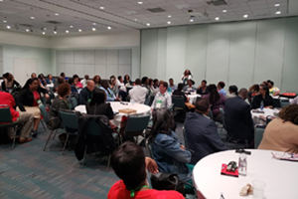
AACRAO BLACK CAUCUS
The mission of the Black Caucus is to support professional development, networking, and the discussion of issues affecting black students and professionals throughout college and university communities.
The Caucus engages in identifying solutions to issues surrounding access as well as examining ways to enhance and increase the representation of both black students and professionals within colleges and universities.

Slide 4
I CAN’T BREATHE
“We are living the Black peoples' reality - we are not safe in the country that we call home. Lived experiences clearly reinforce that regardless of personal and professional achievement, we are NOT immune to the inhumane effects of racism, racial profiling, and hatred. Every morning, we wonder if this is the day that our family or someone we know will become a victim of this cancer in our society.”

Slide 5
THIS TOWN HALL WILL
Be open,
Be honest
Be thought-provoking
Let’s focus on issues and not personalities

Slide 6
RULES OF ETIQUETTE
This is intended as an interactive conversation.
Participants are initially muted until they are ready to comment.
Use the Raise Hand feature to provide feedback.
Use the Chat function to comment.
You do not have to agree with someone else’s comment/statement but let’s be respectful of each other.
Share resources and references that you have found helpful.

Slide 7
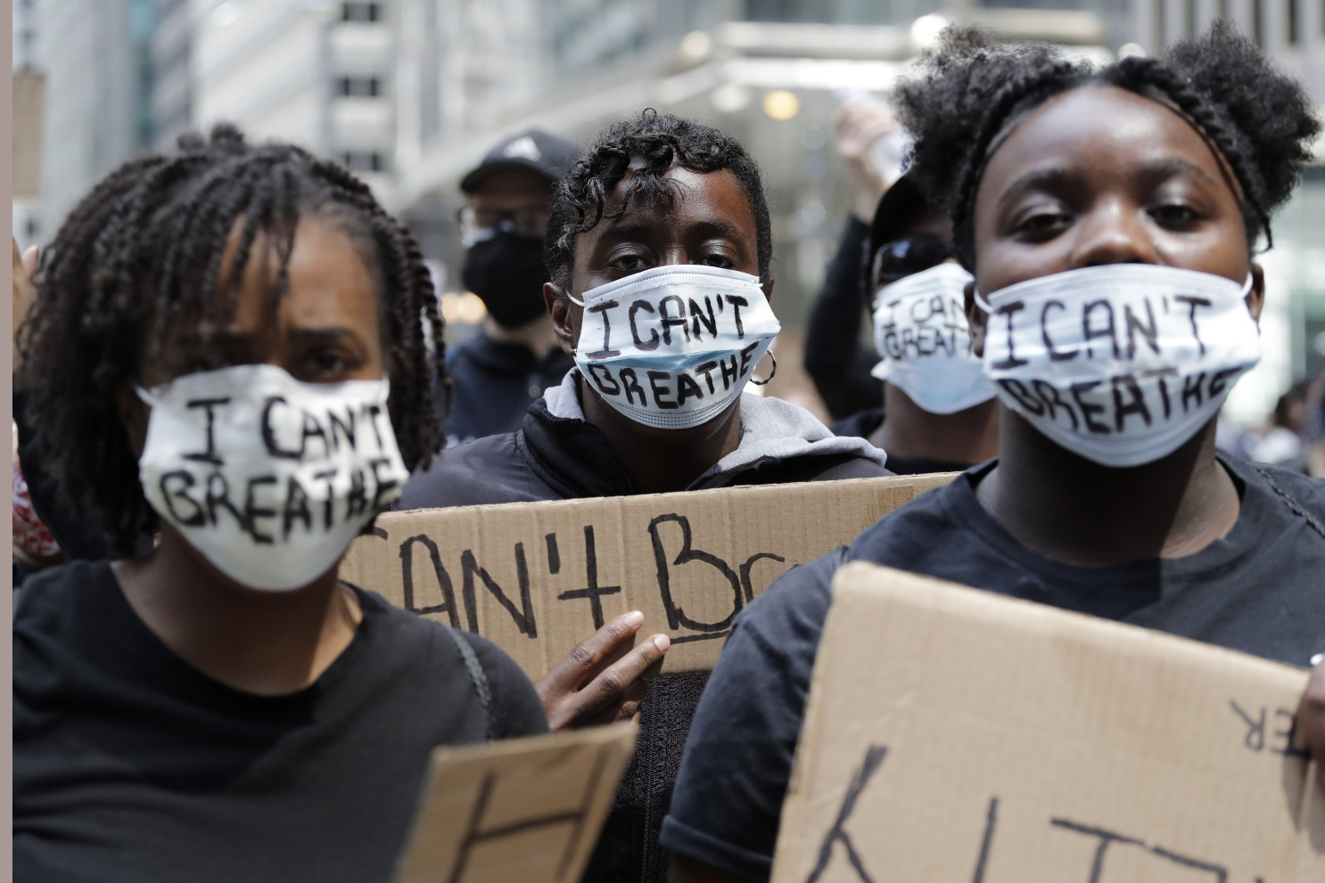
TOWN HALL OUTCOME
Black Caucus
How can we, a national association of educational professionals, use our collective strength to help bring more attention to this issue and set a strategy for improving race relations through meaningful action on a local, regional and national level?

Slide 8
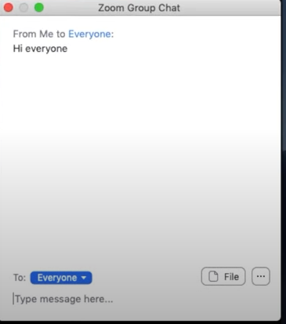
USING THE CHAT FEATURE
Click on the Chat icon at the bottom of your Zoom window.
Chat with Everyone is your default.
Begin typing your message.
To share resources, please add Resource at the beginning of your message. E.g. Resource: White Fragility by Robin DiAngelo.
Click on the Chat icon at the bottom of your Zoom window.
To chat with a specific participant, use the drop-down arrow next to the To: address field and click on the participant’s name.
Begin typing your message.
Be sure to change this option back to Everyone to provide a comment that all participants will read.

Slide 9
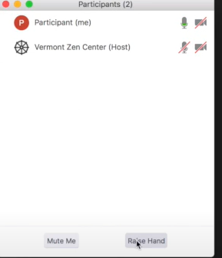
USING THE RAISE THE HAND FEATURE
Click the Participants icon at the bottom of your Zoom window.
A list of Participants will appear in a new window.
At the bottom of the Participant window, there is a Raise Hand button.
Click on the Raise Hand button.
The hosts will be able to see your hand raised and will call on you.
You will be unmuted to provide your comments verbally to all participants.
After you have commented, you will be placed on mute again.

Slide 10
LET’S TALK ABOUT RESOURCES AND SUPPORT
What resources and support mechanisms can we share with one another as we strive to help our fellow members heal and educate those who want to provide support but are not sure where to start?

Slide 11
WHAT’S NEXT FOR US. . .

Slide 12
CALL TO ACTION
This is not a news sensation topic.
Keep talking to each other about the issues.
Help others understand the issues and provide solutions.
Recruit people who can be allies for action.
Develop a repository of resources, references and support. Host in a open environment (i.e. online).
Create a workgroup to begin reviewing and making policy changes. Use our national organization to elevate this platform.

Slide 13
THANK YOU FOR PARTICIPATING
Black Caucus

